Slide 1
String Handling
Abhishek S. Rao

Slide 2
Implementing strings as built-in objects allows Java to provide a full complement of features that make string handling convenient. For example, Java has methods to compare two strings, search for a substring, concatenate two strings, and change the case of letters within a string.
Somewhat unexpectedly, when you create a String object, you are creating a string that cannot be changed. That is, once a String object has been created, you cannot change the characters that comprise that string. At first, this may seem to be a serious restriction. However, such is not the case. You can still perform all types of string operations.
The difference is that each time you need an altered version of an existing string, a new String object is created that contains the modifications. The original string is left unchanged. This approach is used because fixed, immutable strings can be implemented more efficiently than changeable ones. For those cases in which a modifiable string is desired, Java provides two options: StringBuffer and StringBuilder. Both hold strings that can be modified after they are created.

Slide 3
The String, StringBuffer, and StringBuilder classes are defined in java.lang. Thus, they are available to all programs automatically. All are declared final, which means that none of these classes may be subclassed. This allows certain optimizations that increase performance to take place on common string operations.

Slide 4
The String Constructors
The String class supports several constructors. To create an empty String, call the default constructor. For example, String s = new String();
will create an instance of String with no characters in it. Frequently, you will want to create strings that have initial values. The String class provides a variety of constructors to handle this. To create a String initialized by an array of characters, use the constructor shown here:
String(char chars[ ])
Here is an example:

Slide 5
You can specify a subrange of a character array as an initializer using the following constructor:
String(char chars[ ], int startIndex, int numChars)
Here, startIndex specifies the index at which the subrange begins, and numChars specifies the number of characters to use. Here is an example:

Slide 8
String Length
The length of a string is the number of characters that it contains. To obtain this
value, call the length( ) method, shown here:
int length( )
The following fragment prints "3", since there are three characters in the string s:

Slide 9
Special String Operations
Because strings are a common and important part of programming, Java has added special support for several string operations within the syntax of the language. These operations include the automatic creation of new String instances from string literals, concatenation of multiple String objects by use of the + operator, and the conversion of other data types to a string representation. There are explicit methods available to perform all of these functions, but Java does them automatically as a convenience for the programmer and to add clarity.

Slide 10
String Literals
For each string literal in your program, Java automatically constructs a String object. Thus, you can use a string literal to initialize a String object. For example, the following code fragment creates two equivalent strings:

Slide 11
String Concatenation
In general, Java does not allow operators to be applied to String objects. The one exception to this rule is the + operator, which concatenates two strings, producing a String object as the result. This allows you to chain together a series of + operations. For example, the following fragment concatenates three strings:

Slide 13
String Conversion and toString( )
When Java converts data into its string representation during concatenation, it does so by calling one of the overloaded versions of the string conversion method valueOf( ) defined by String. valueOf( ) is overloaded for all the primitive types and for type Object.
For the primitive types, valueOf( ) returns a string that contains the human-readable equivalent of the value with which it is called. For objects, valueOf( ) calls the toString( ) method on the object.

Slide 14
Every class implements toString( ) because it is defined by Object. However, the default implementation of toString( ) is seldom sufficient. For most important classes that you create, you will want to override toString( ) and provide your own string representations. Fortunately, this is easy to do. The toString( ) method has this general form:
String toString( )
To implement toString( ), simply return a String object that contains the humanreadable string that appropriately describes an object of your class.
By overriding toString( ) for classes that you create, you allow them to be fully integrated into Java’s programming environment. For example, they can be used in print( ) and println( ) statements and in concatenation expressions. The following program demonstrates this by overriding toString( ) for the Box class:

Slide 16
Character Extraction
The String class provides a number of ways in which characters can be extracted from a String object. Several are examined here. Although the characters that comprise a string within a String object cannot be indexed as if they were a character array, many of the String methods employ an index (or offset) into the string for their operation. Like arrays, the string indexes begin at zero.

Slide 17
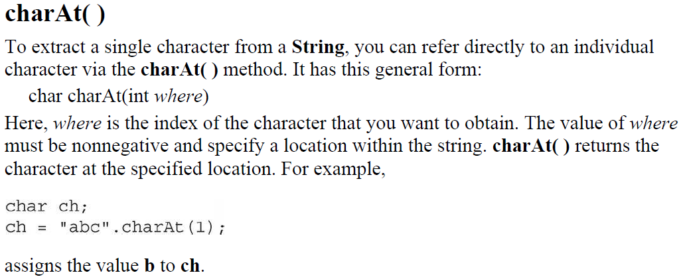

Slide 18
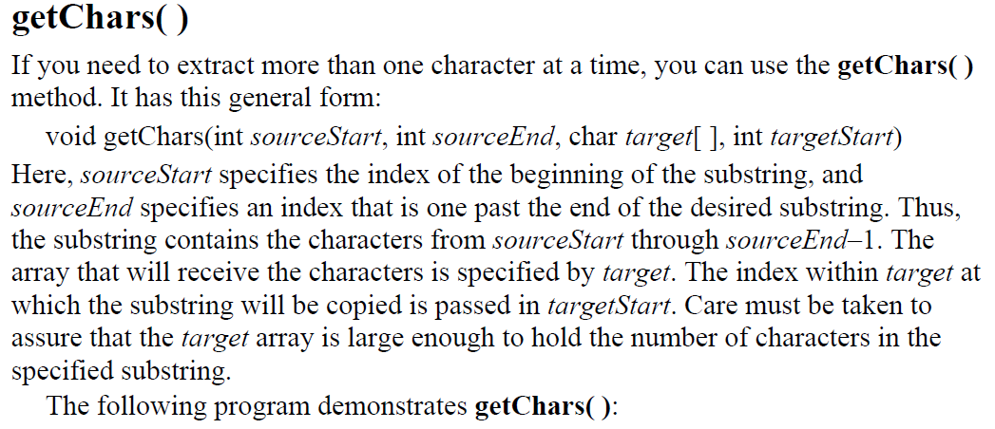

Slide 20
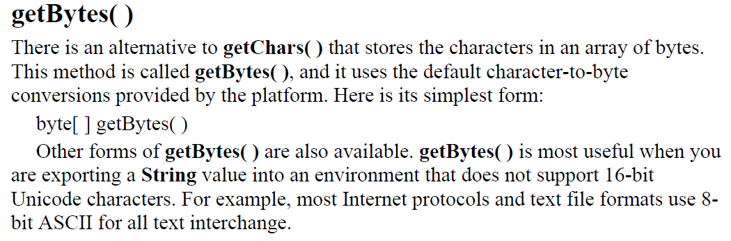
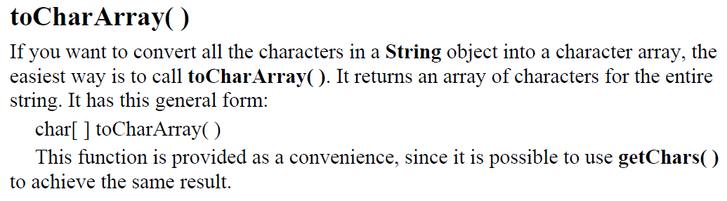

Slide 21
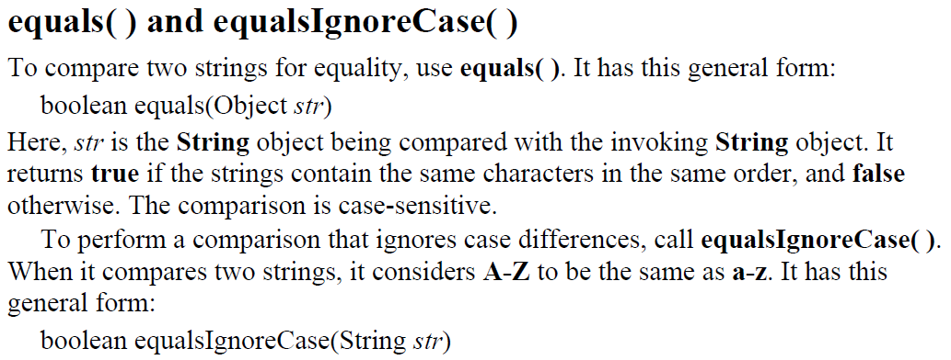
String Comparison
The String class includes a number of methods that compare strings or substrings within strings.

Slide 23
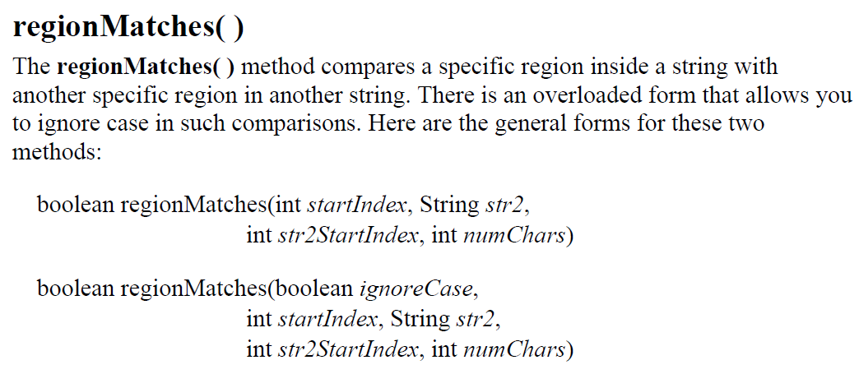

Slide 24
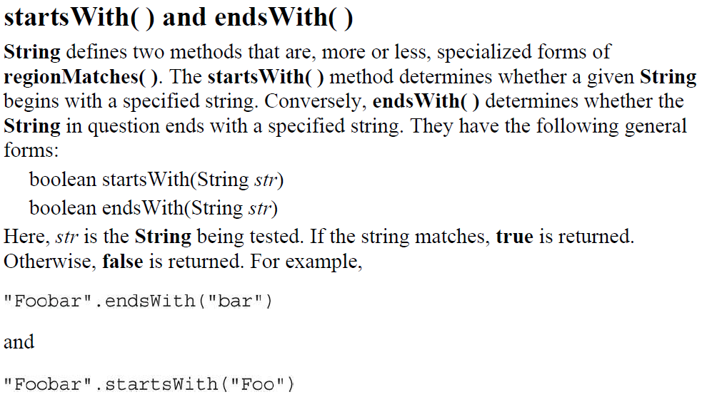

Slide 25
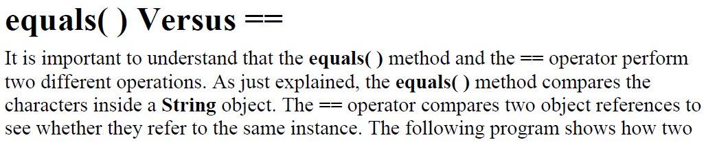

Slide 26
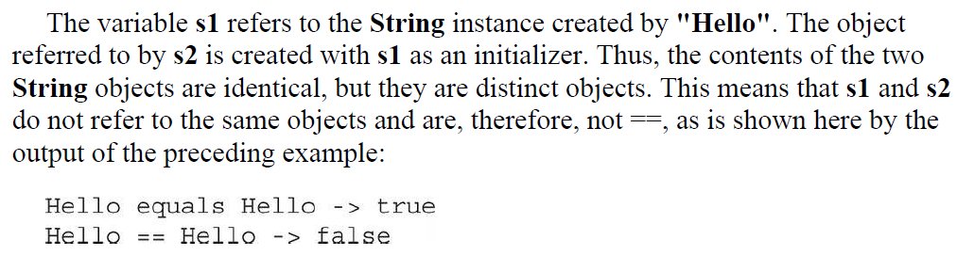

Slide 27
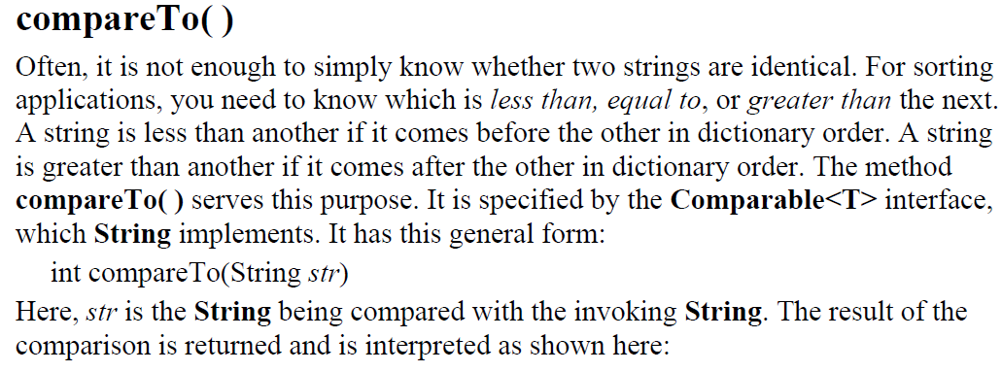

Slide 29
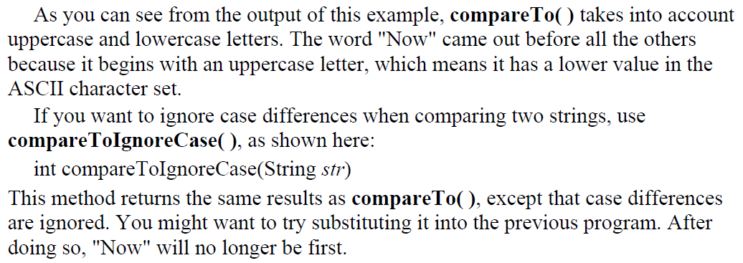

Slide 30
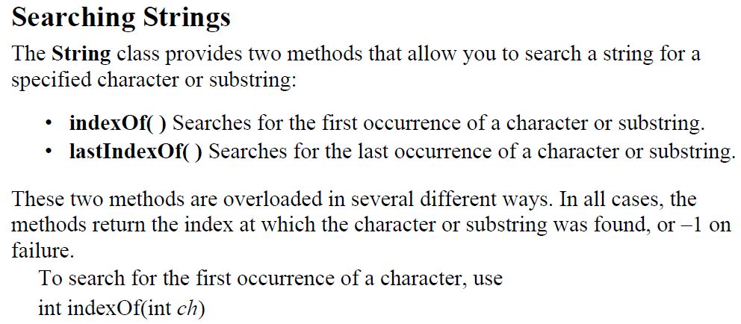

Slide 33
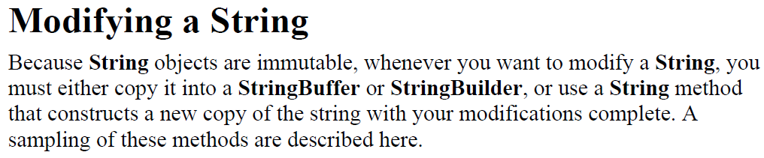

Slide 34
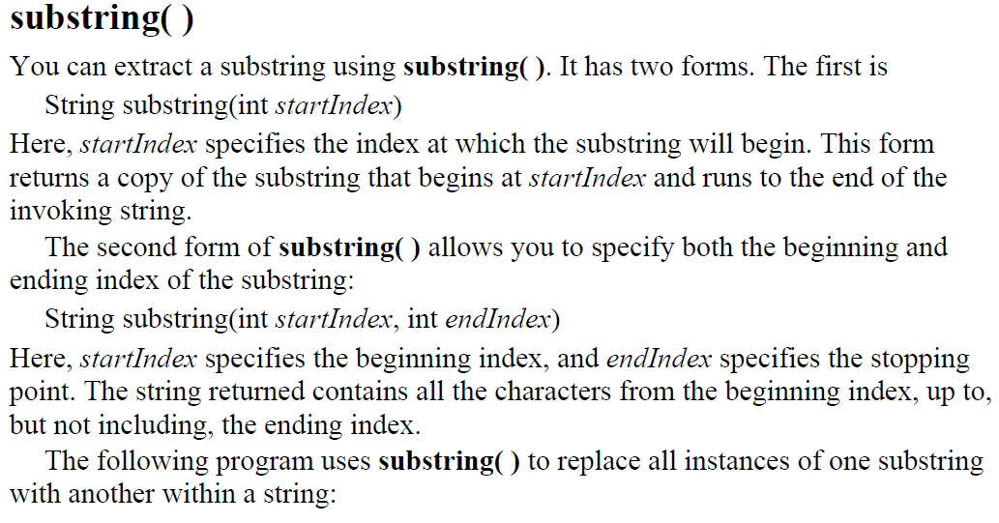

Slide 37
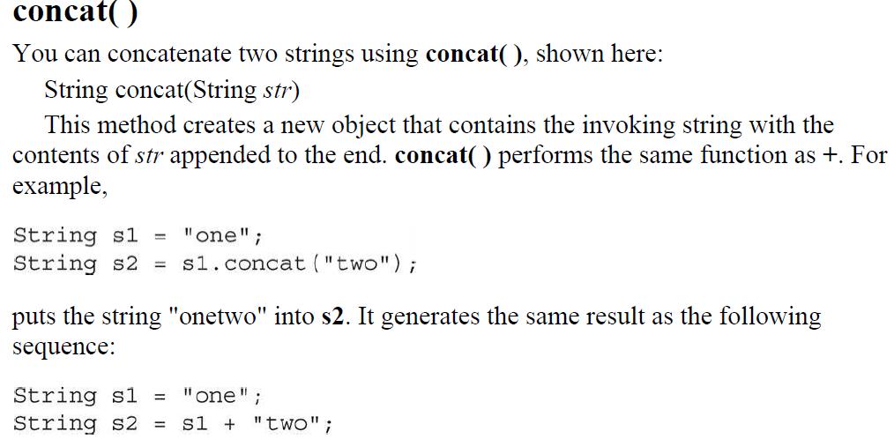

Slide 38
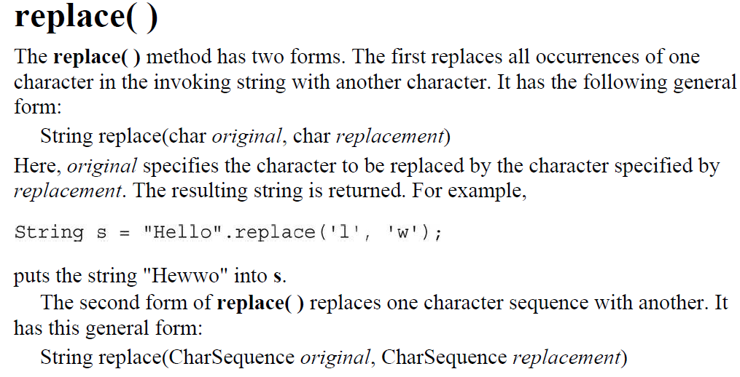

Slide 39
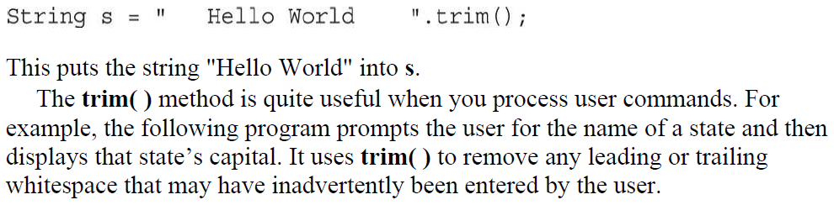
trim( )
The trim( ) method returns a copy of the invoking string from which any leading and trailing whitespace has been removed. It has this general form:
String trim( )
Here is an example:

Slide 41
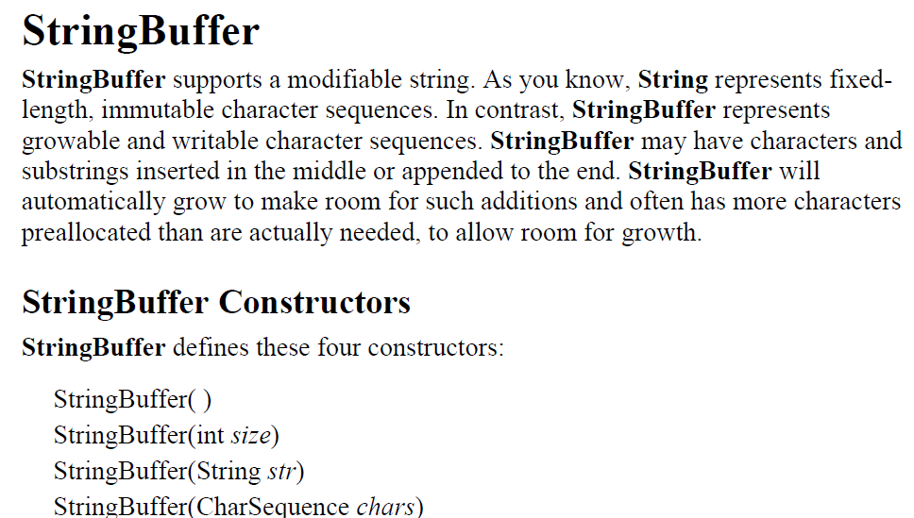

Slide 42
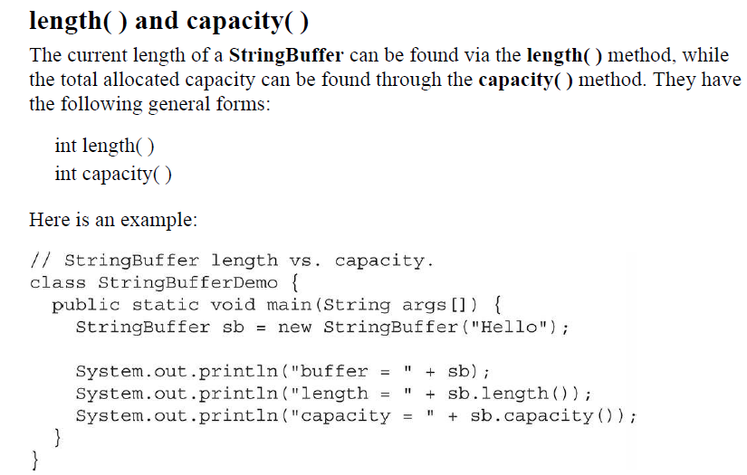

Slide 43
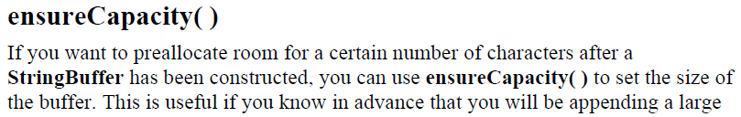
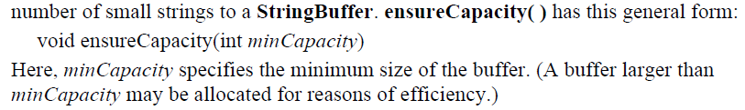

Slide 44
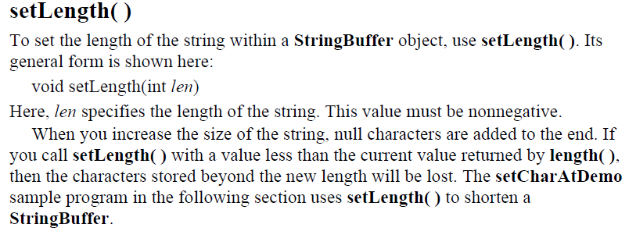

Slide 45
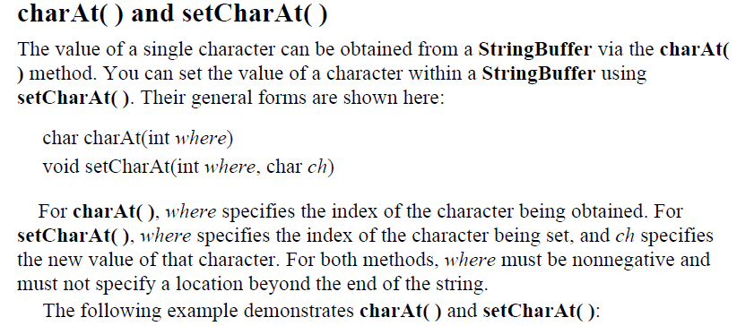

Slide 47
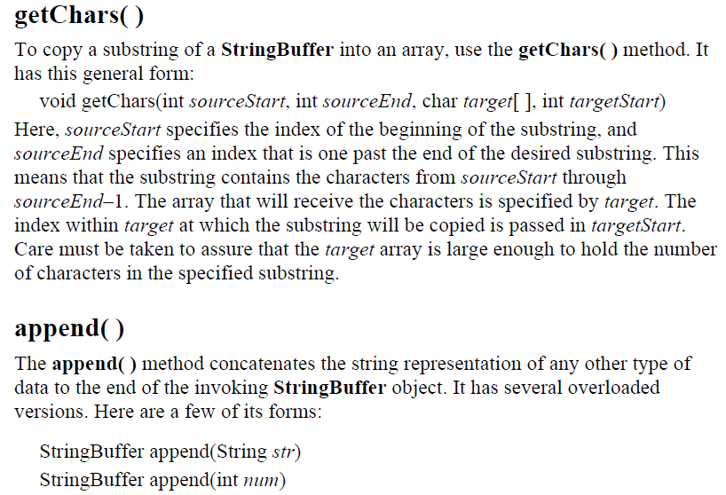

Slide 48
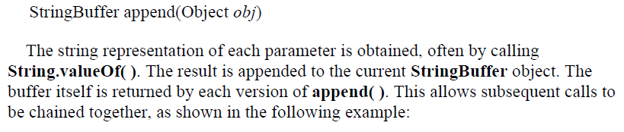

Slide 49
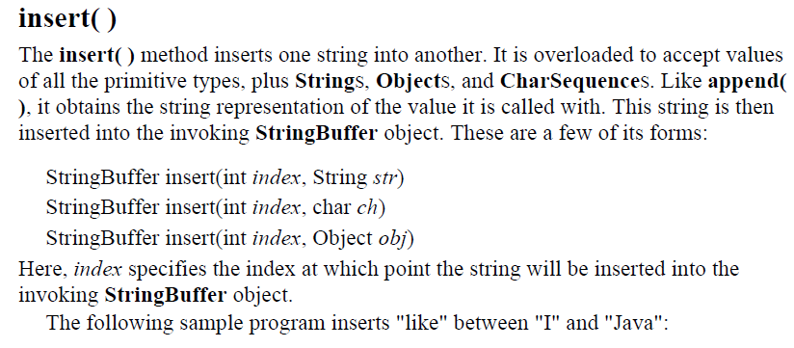

Slide 51
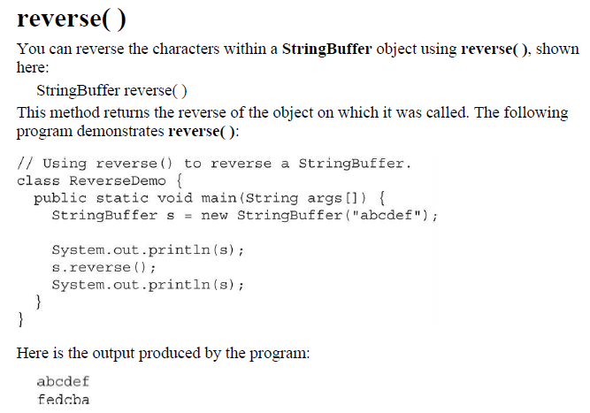

Slide 52
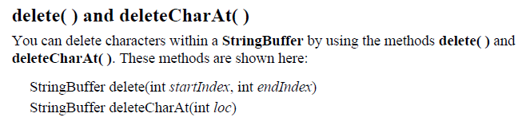
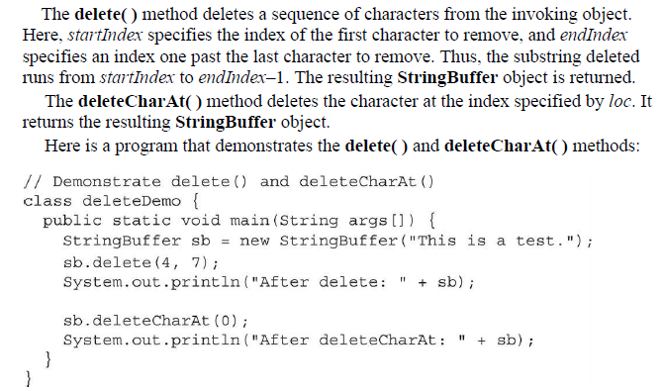

Slide 53
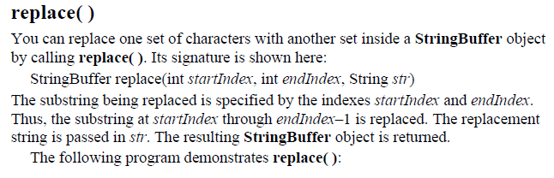

Slide 54
